Slide 1
Attention based Encoder Decoder Calculations
CMR@BRACU

Slide 2
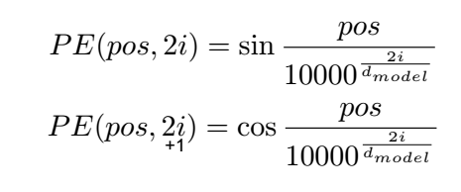
Encoder
From (1) [1.87,1.09] [-1.68,0.67]
+ [2.5, -2.1] + [2.5, -2.1]
[4.37, -1.01] [0.82, -1.43]
Lets go
[1.87, 0.09] [-0.78, 0.27]
Positional encoding
+[0.0,1,0] +[-0.9,0.4]
[1.87,1.09] [-1.68,0.67] ………………….(1)
Attention calculation in encoder (Lets go)
Q=1.1 0.6 K = -1.7 0.5 V = 1.5 -1.0 -2.8 2.4 -1.5 0.9 -0.3 -0.2
QL = Lets X Q KL = Lets X K VL = Lets X V QG = go X Q KG = go X K VG = go X V
QL = [-1.0, 3.7] KL = [-4.7,1.9] VL = [2.5,-2.1] QG =[-3.7, 0.6] KG = [1.9,-0.2] VG = [-2.7,1.5]
QLxKL = 11.7 QLxKG = -2.6 QGxKL = 18.5 QGxKG = -7.2 Softmax(11.7,-2.6) Softmax(18.5.-7.2) 1.0, 0.0 1.0, 0.0 VLx1.0 + VGx0 VLx1.0 + VGx0.0 [2.5, -2.1] [2,5, -2.1]
Decoder
Attention calculation in decoder (EOS)
EOS [2.70, -1.34] + positional encoding [0.0, 1.0] = [2.70,-0.34]
Q=0.4 0.4 K = 0.4 -0.7 V = -1.1 -0.7 -0.3 0.1 -0.4 0.3 -0.4 1.3
QE = EOSXQ KE = EOSXK VE = EOSXV QE = [1,2,1.0] KE = [1.2, -1.8] VE = [-2.8, -2.3]
QEXKE = -0.4 Softmax(-0.4) = 1.0 EOS[2.70, -0.34] + VE X 1.0 = [-0.1, -2.6]……………….(2)

Slide 3
Decoder Encoder cross attention calculation (EOS, Lets, go)
Q=1.5 -0.3 K = -1.1 0.3 V = 1.1 0.6 0.3 -1.0 -0.3 -0.8 -1.2 -0.5
QE = EOS X Q KL = Lets X K KG = go X K VL = Lets X V VG = go X V
QE = [-0.9, 2.6] KL = [-4.5,2.1] VL = [6.0, 3.1] KG = [-0.5,1.4] VG = [2.6,1.2]
QExKL = 9.5 QExKG = 4.1 Softmax(9.5,4.1) 1.0, 0.0 VLx1.0 + VGx0 [6.0, 3.1]
From (2) EOS [-0.1, -2.6] + [6.0.3.1] = [5.9,0.5] ………(3)

Slide 4
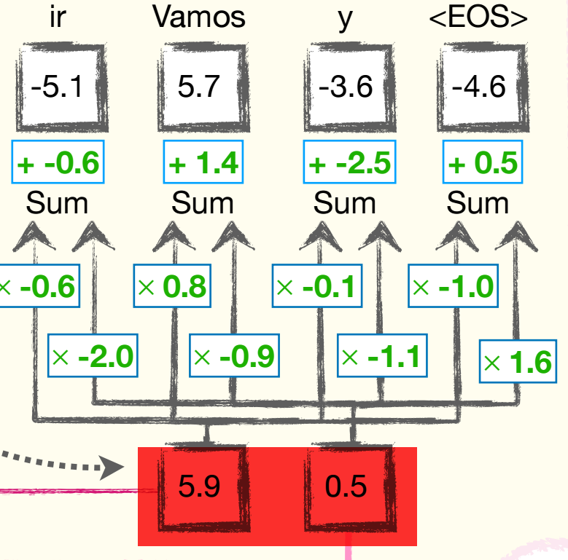
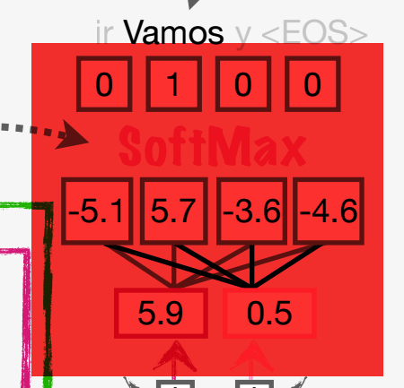
Generating first token in decoder after processing EOS

Slide 5
Decoder
Decoder Encoder cross attention (Vamos, Lets, go)
Q=1.5 -0.3 K = -1.1 0.3 V = 1.1 0.6 0.3 -1.0 -0.3 -0.8 -1.2 -0.5
QV = vamos X Q KL = Lets X K KG = go X K VL = Lets X V VG = go X V
QV = [-0.1, -5.1] KL = [-4.5,2.1] VL = [6.0, 3.1] KG = [-0.5,1.4] VG = [2.6,1.2]
QVxKL = -10.3 QVxKG = -7.1 Softmax(-10.3,-7.1) 0.0, 1.0 VLx0.0 + VGx1.0 [2.6,1.2]
From (4) Vamos [-1.2,5.5] + [2.6,1.2] = [1.4,6.7] ………(5)
Attention calculation in decoder (Vamos, EOS)
Vamos [-0.86,2.37] + positional encoding [-0.9,0.4] = [-0.86,2.37]
Q=0.4 0.4 K = 0.4 -0.7 V = -1.1 -0.7 -0.3 0.1 -0.4 0.3 -0.4 1.3
KE = EOSXK VE = EOSXV QV = Vamos X Q VV = vamos X V KE = [1.2, -1.8] VE = [-2.8, -2.3] QV = [-1.3, -0.1] VV = [0.0, 3.7]
QVXKE = -1.1 QVXKV = 1.4 Softmax(-1.1, -1.4) = 0.1,0.9 varmos[-0.86, 2.37] + VE X 0.1 + VVX0.9 = [-1.2, 5.5] ……………….(4)

Slide 6
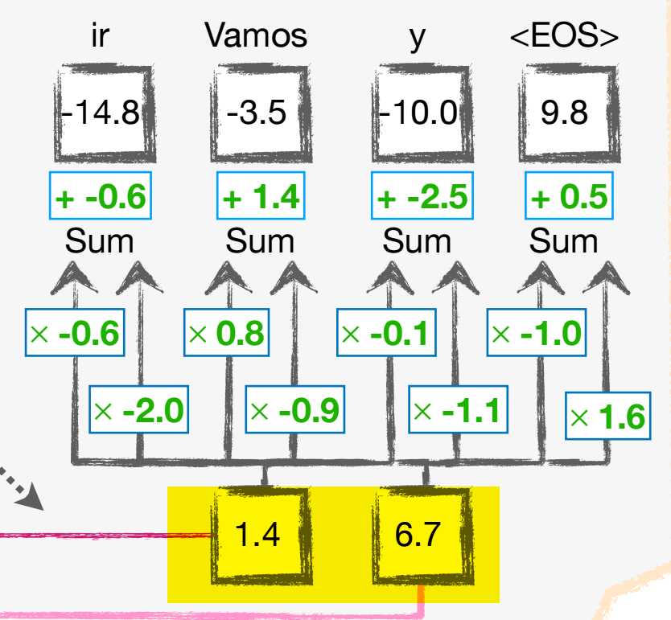
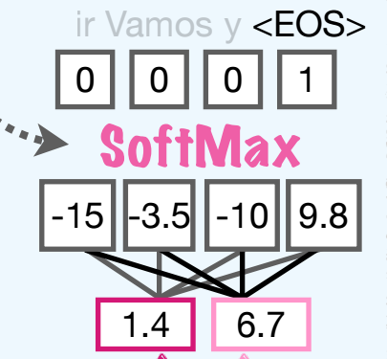

Slide 7
